Slide 1
Classifying
Small Ballet jumps with
Machine Learning
ANA BOBURG NYSTEDT
ALLYSON BIERYLA
Harvard Extension School
DGMD-14

Slide 2
Video

Slide 3
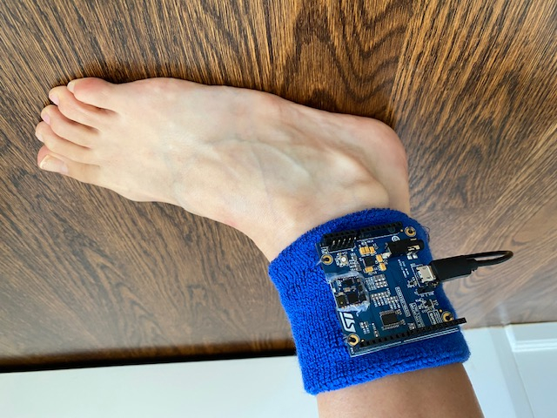
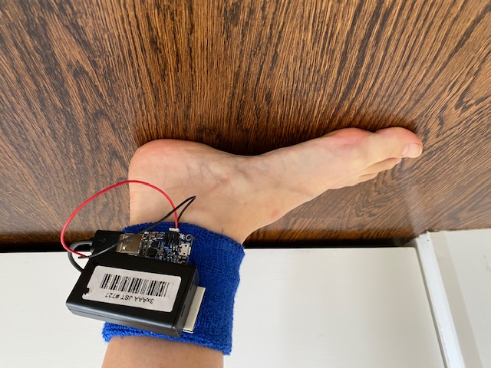
PROTOTYPE 1
Secured and tested sensor on ankle
Took test images using 3 AAA battery pack, but found it to be too big

Slide 4
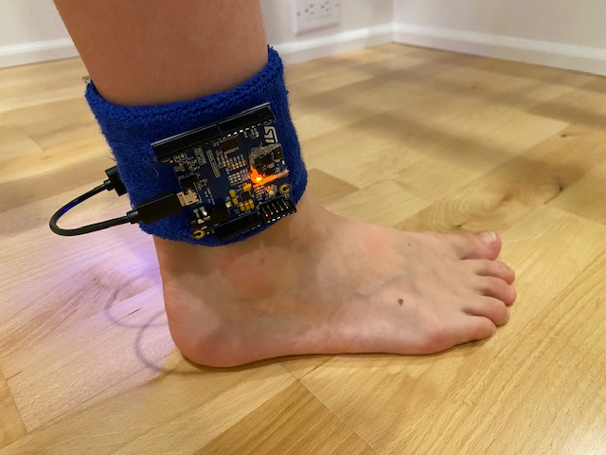
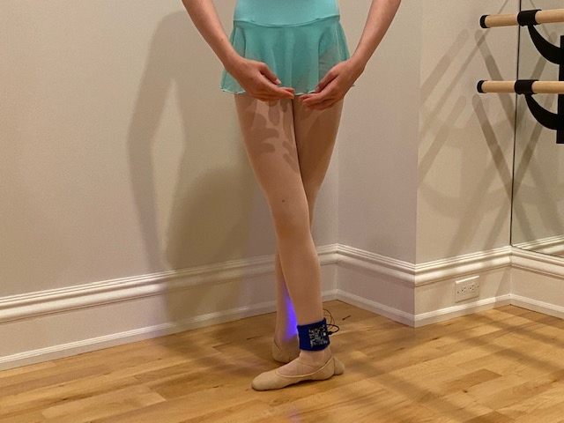
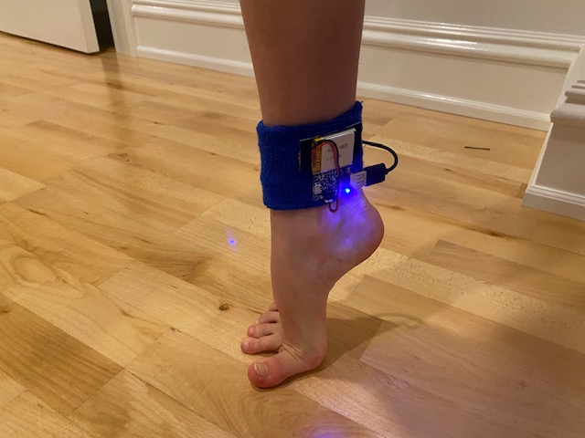
FINAL PROTOTYPE
Final design uses a Lithium Ion battery (3.7V 500 mAh with power boost) -

Slide 5

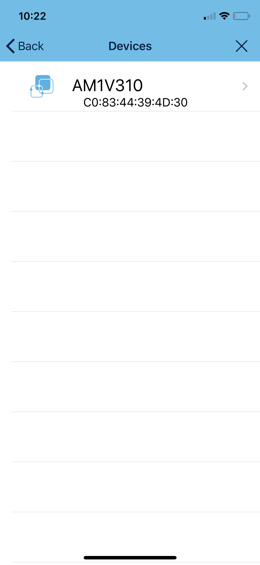
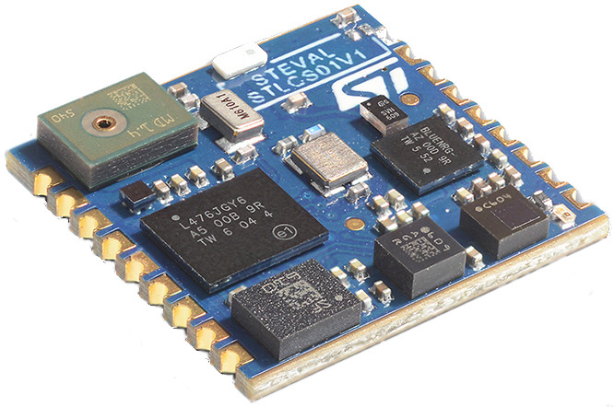

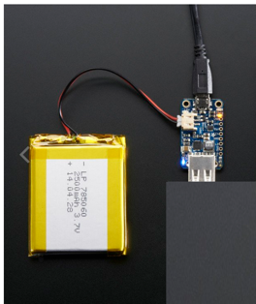
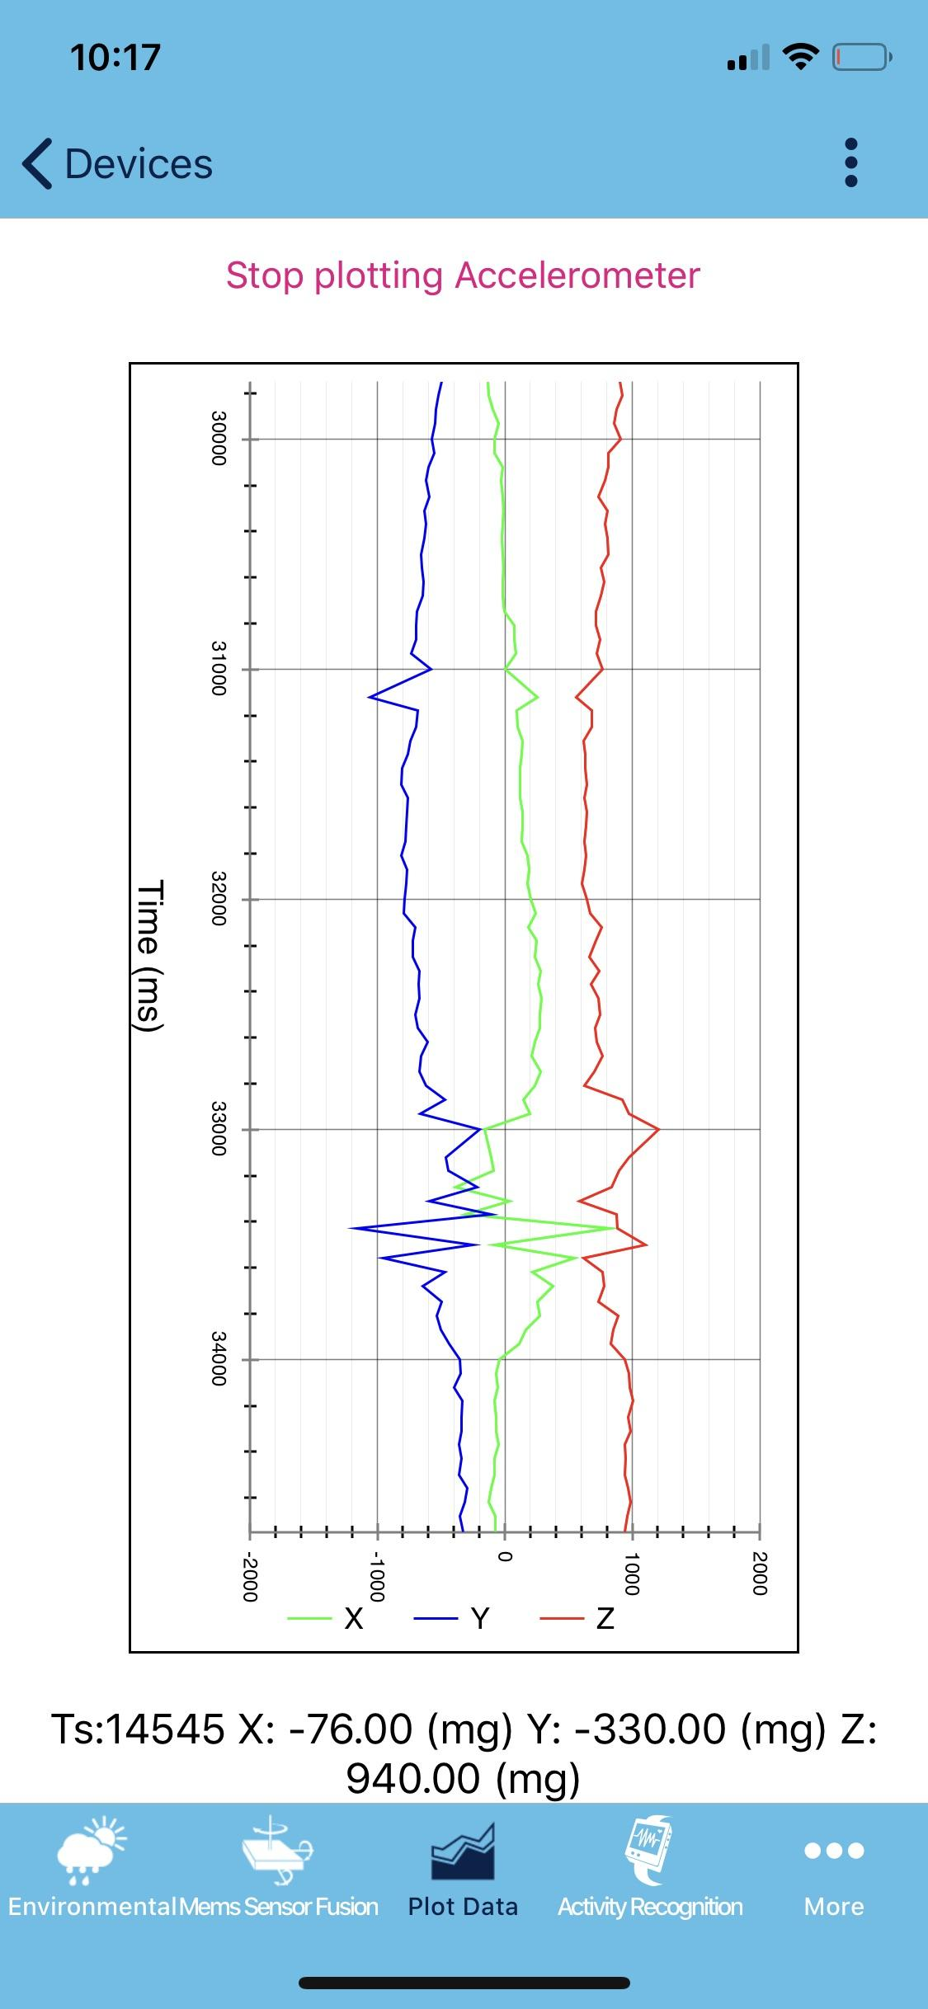


ST Sensor
System Setup
+
ST Sensor BLE iPhone app
Python
Machine Learning Models

Slide 6
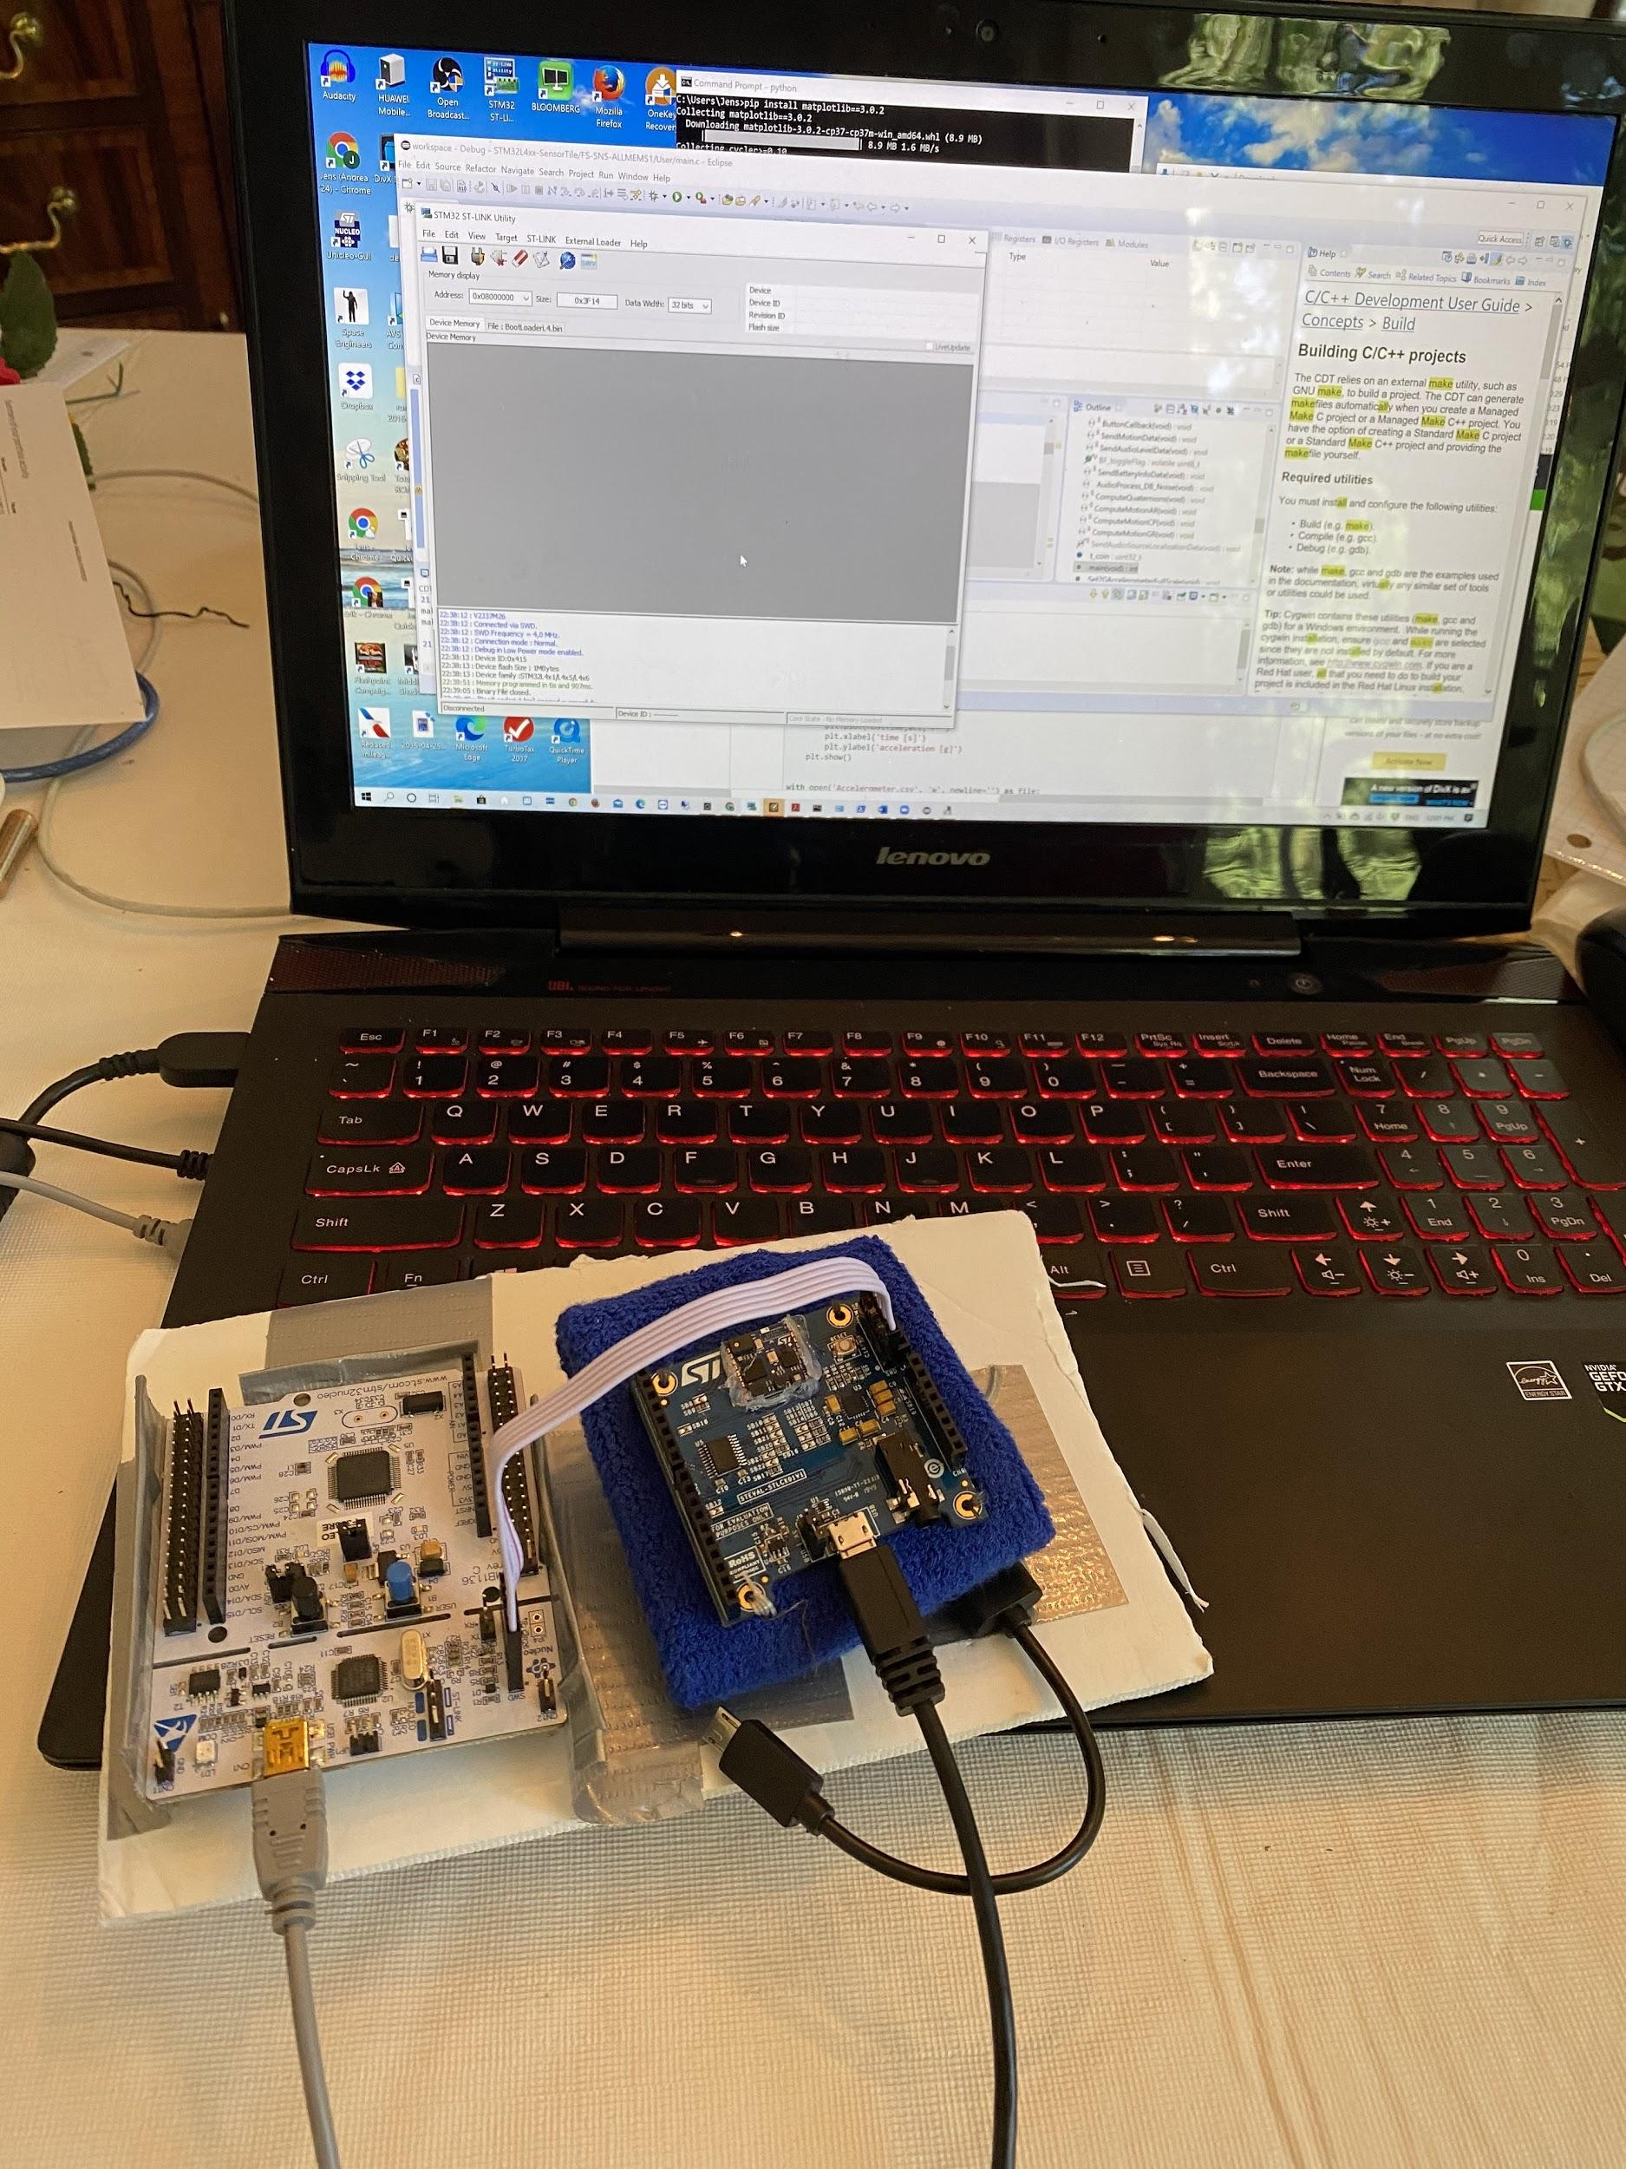
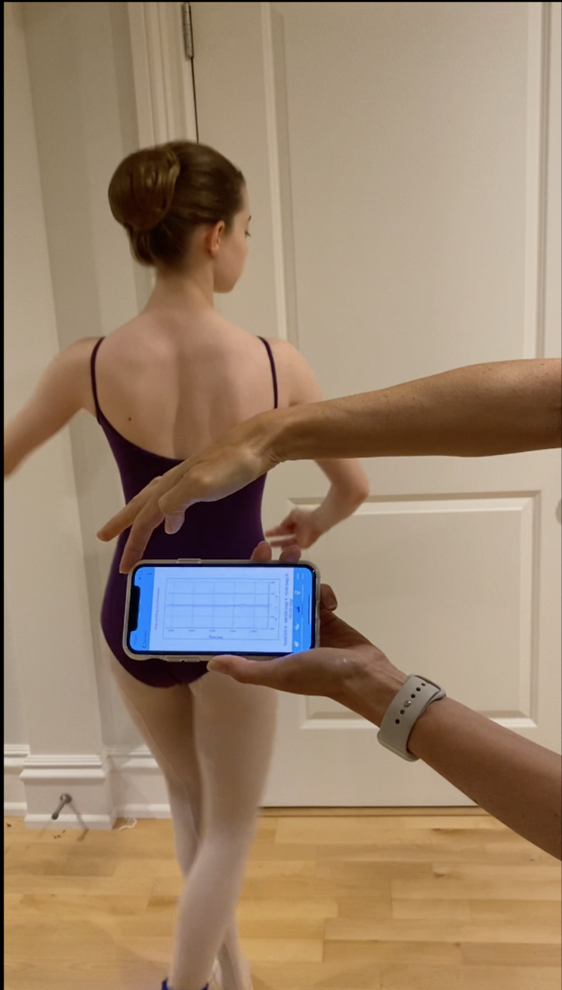
Flash the SensorTile with data collection program
Start Data Collection

Slide 7
DATA COLLECTION
Collected data using ST Sensor BLE and the SensorTile (Accelerometer, Gyro and Magnetometer) of three types of ballet jumps (jete, pas-de-chat and glissade)
3 datasets (~50 repetitions for each type of jump) from an intermediate skill-level dancer
Divided the datasets - 40 jumps for training, and remaining jumps (~10-13) for testing of each type of jump
Additionally, we collected data (~10 repetitions for each type of jump) from a beginner skill-level dancer to further test the models

Slide 8
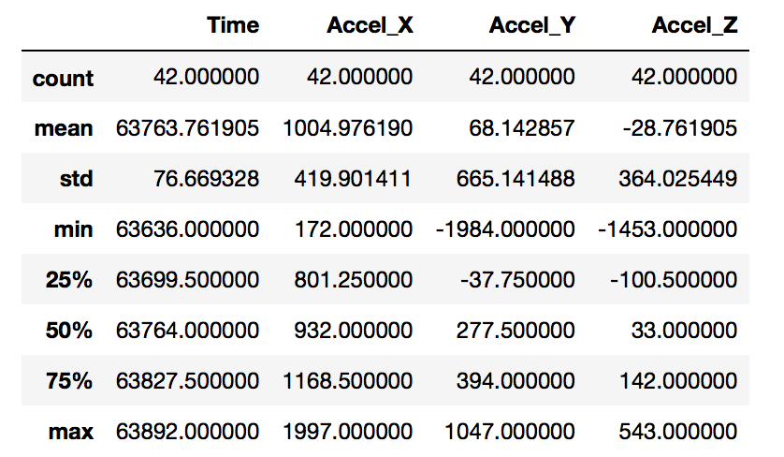
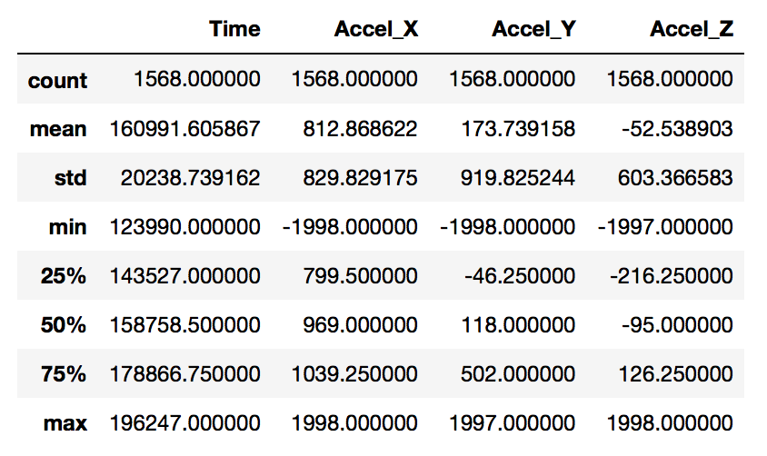
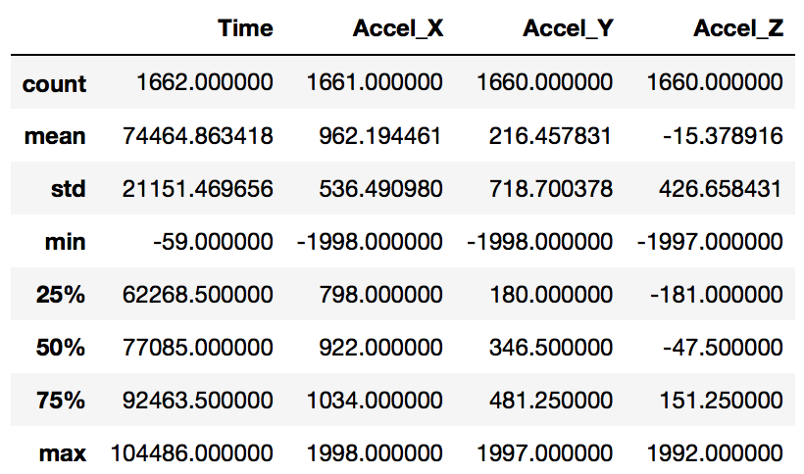
Software
Glissade
Python was used to visualize and summarize the Acceleration and Gyroscope components of the jumps to determine what features best summarize the data for training the SVM model
Jete
Pas-de-chat

Slide 9
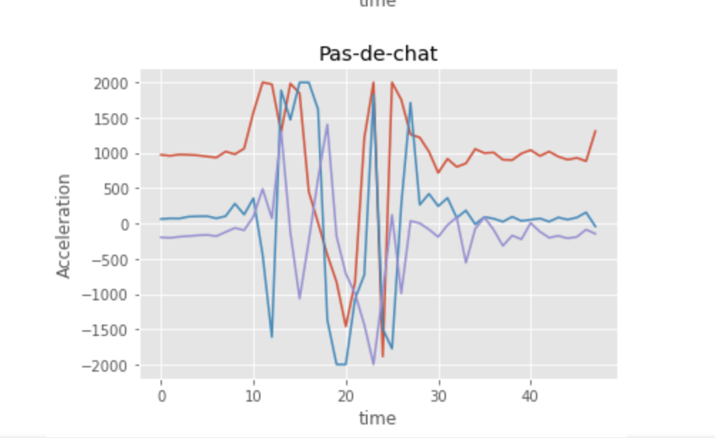
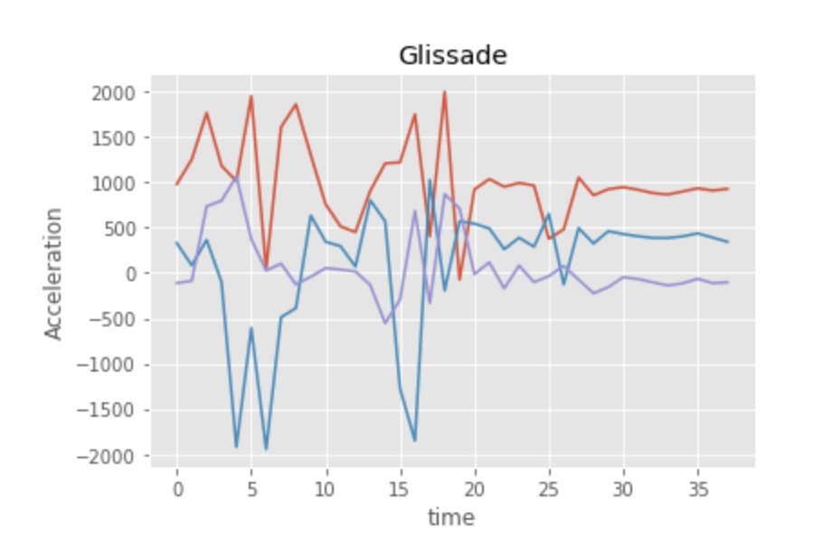
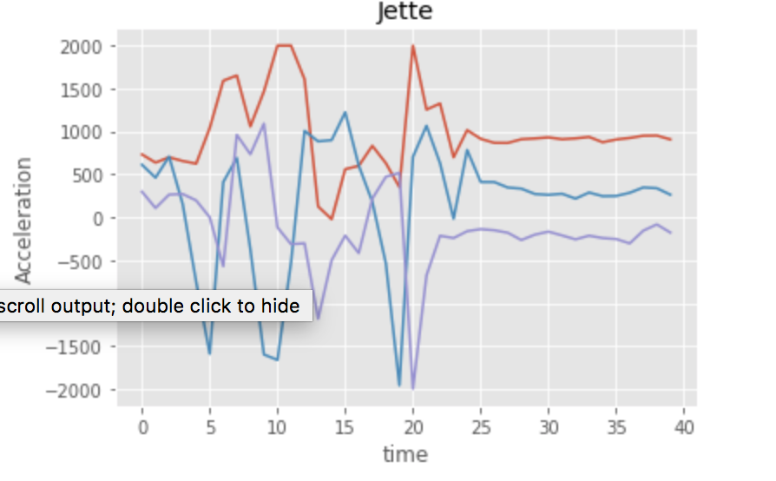
Visualizing Acceleration Data
100 Hz- Sampling rate (10 ms)
Acc - Full scale +/- 2G (it may have been better to increase it to 4G)

Slide 10
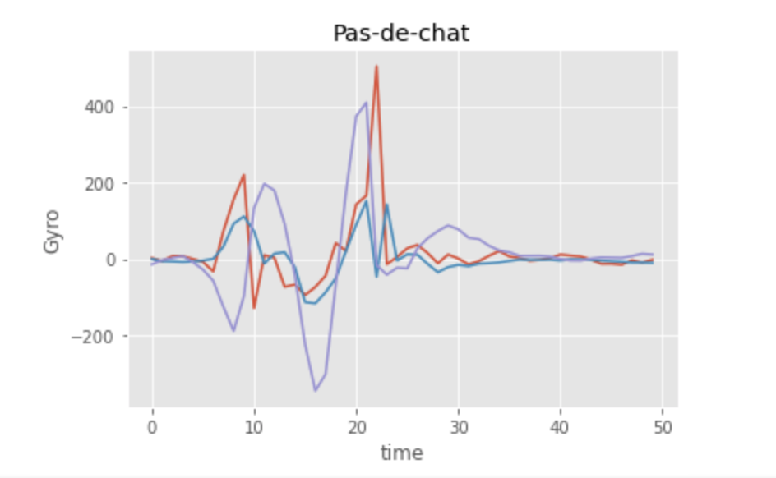
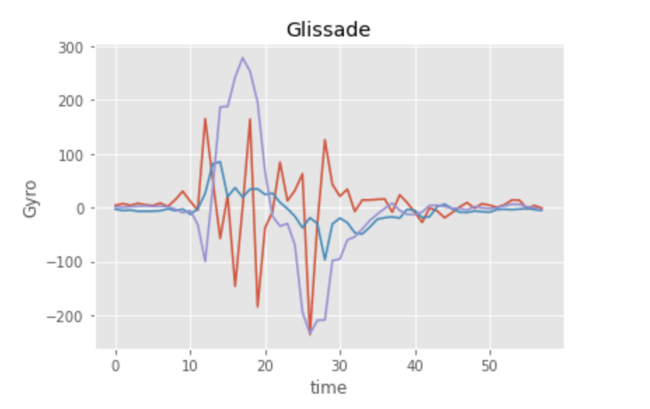
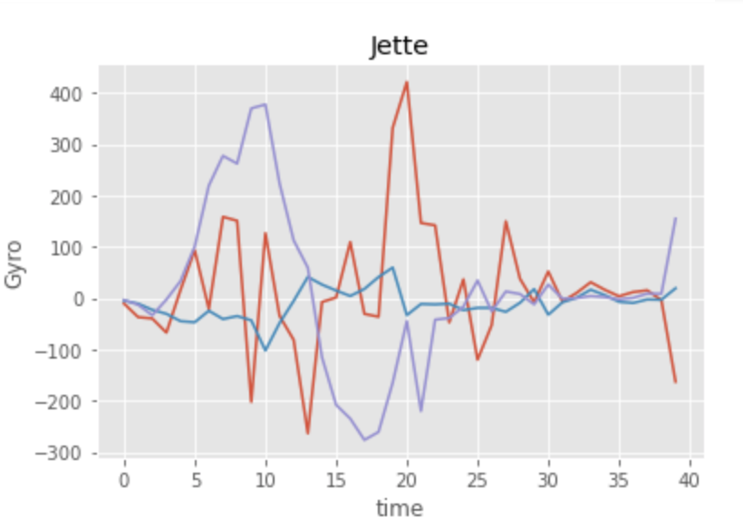
Visualizing Gyroscope Data
Gyro- Full scale 500? (+/-.5 dps? )

Slide 11
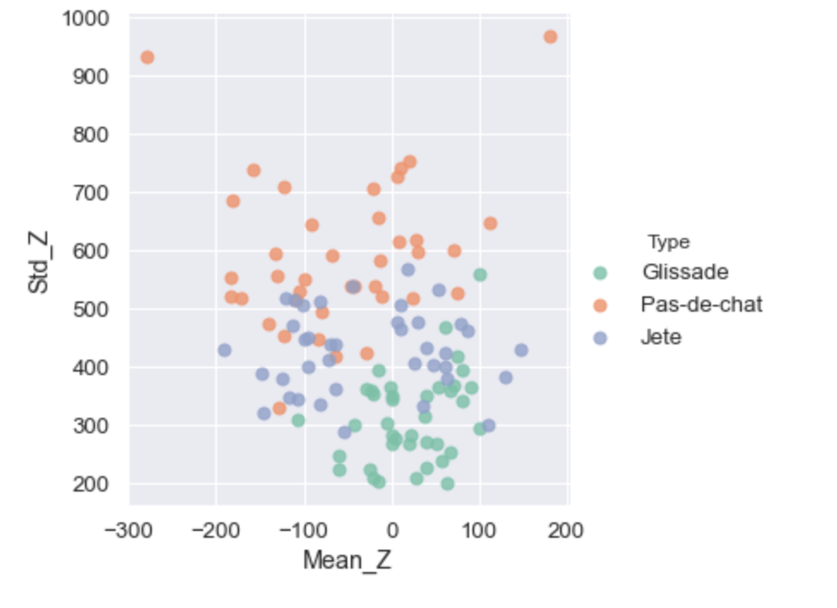
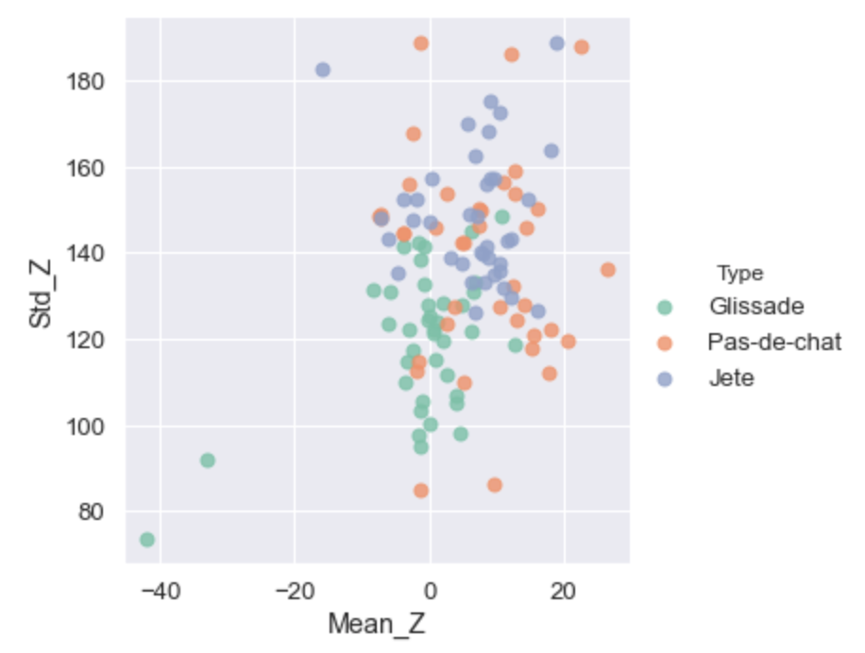
Visualizing the FEATURES
ACCEL FEATURES
GYRO FEATURES

Slide 12
Machine Learning Model - training set
TRAINING data
Extracted FEATURES from acceleration datasets [Mean (Acc_Z) and Std (Acc_Z)]
40 individual jumps for each type were available to train the model
Visually inspected each training dataset to look for bad data (removed 1 jump from each training set due to noisy data or bad jump timing (i.e. half a jump))
Ultimately used 39 individual jumps of each jump type to train the models
Trained 3 SVM.SVC models to classify the jumps using different kernels:
LINEAR
RBF (C=1, gamma=0.001)
POLYNOMIAL- degree 2 (C=1, gamma=auto)

Slide 13
Machine Learning Model - test datasets
Intermediate Dancer (same person who provided the training data)
Glissade - 10 jumps
Pas-de-chat - 10 jumps
Jete - 13 jumps
Beginner Dancer (beginning skill-level dancer)
Glissade - 10 jumps
Pas-de-chat - 10 jumps
Jete - 11 jumps

Slide 14
MODEL FLOW CHART
DATA Collection
Accel.
Gyro.
Magnet.
SVM Model Classification
Linear
POLY (degree 2)
RBF
DATA CLEANING
FEATURE Extraction
Mean_Z
Std_Z

Slide 15
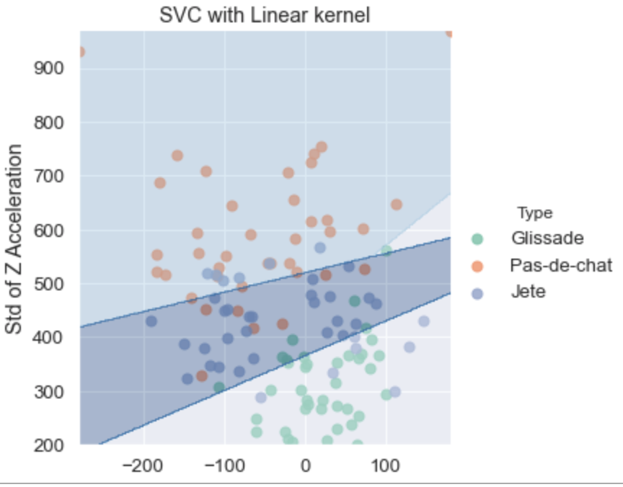
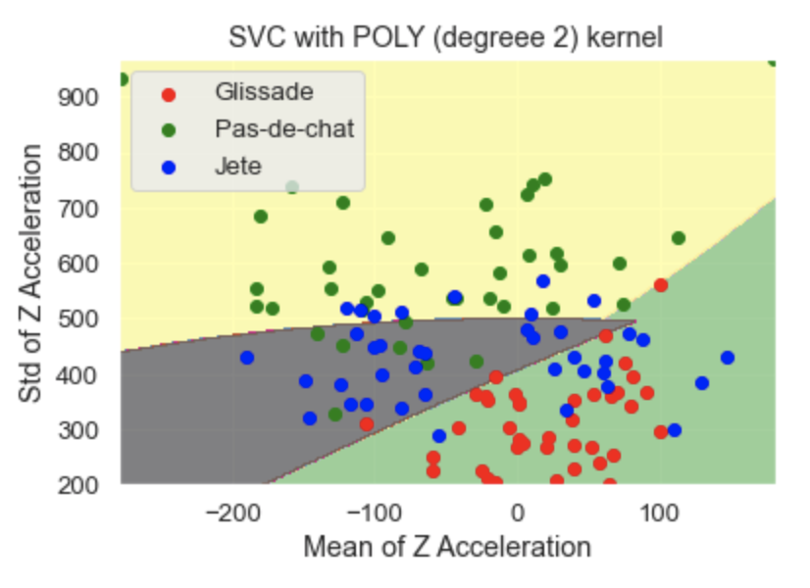
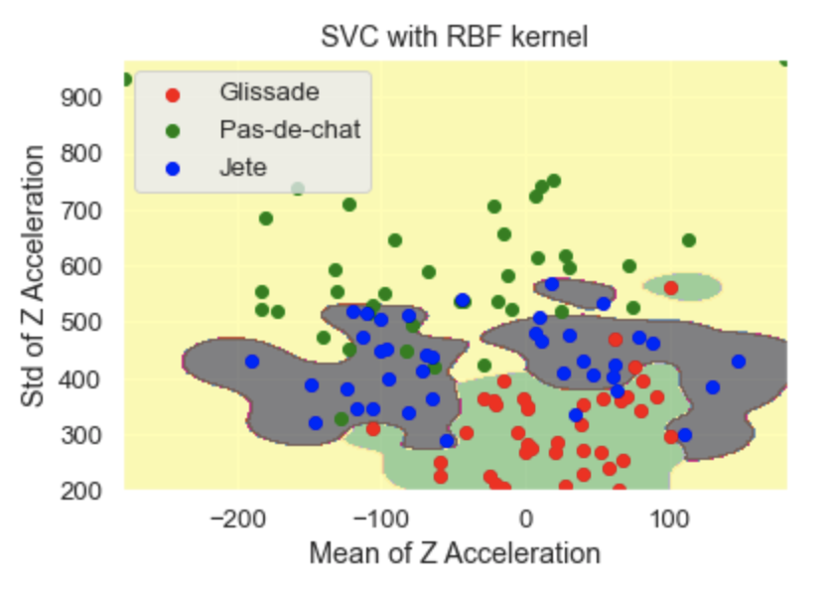
Visualizing the MODELS

Slide 16
Results - Jete dataset 1
 | LINEAR | POLY degree 2 | RBF
Glissade (intermediate) | 8/10 jumps -- 80% | 10/10 jumps -- 100% | 7/10 jumps -- 70%
Glissade (beginner) | 6/10 jumps -- 60% | 8/10 jumps -- 80% | 5/10 jumps -- 50%
Pas-de-chat (intermediate) | 9/10 jumps -- 90% | 9/10 jumps -- 90% | 10/10 jumps -- 100%
Pas-de-chat (beginner) | 3/10 jumps -- 30% | 3/10 jumps -- 30% | 5/10 jumps -- 50%
Jete (intermediate) | 5/13 jumps -- 38% 7/13 jumps -- 54% (test 2) | 4/13 jumps -- 31% 1/13 jumps -- 8% (test 2) | 4/13 jumps -- 31% 6/13 jumps -- 46% (test 2)
Jete (beginner) | 9/11 jumps -- 82% | 7/11 jumps -- 64% | 7/11 jumps -- 71%
Accuracy table for SVM models using Acceleration features (Mean_Z and Std_Z)
Total Accuracy Intermediate dancer | 67% | 70% | 64%

Slide 17
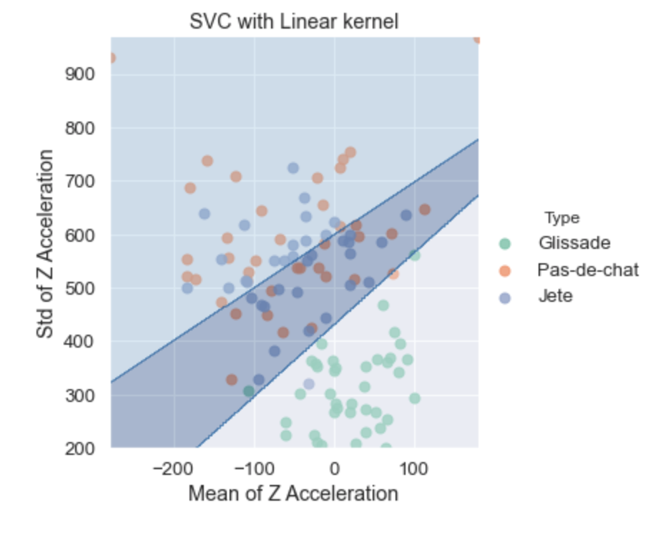
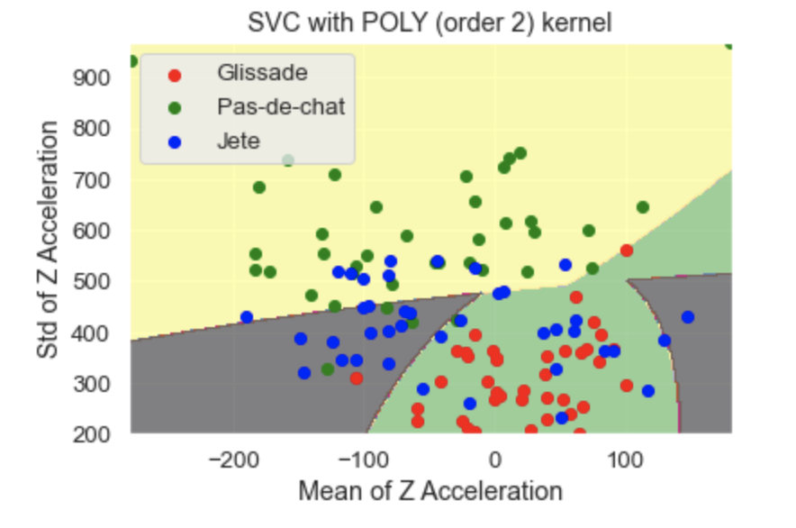
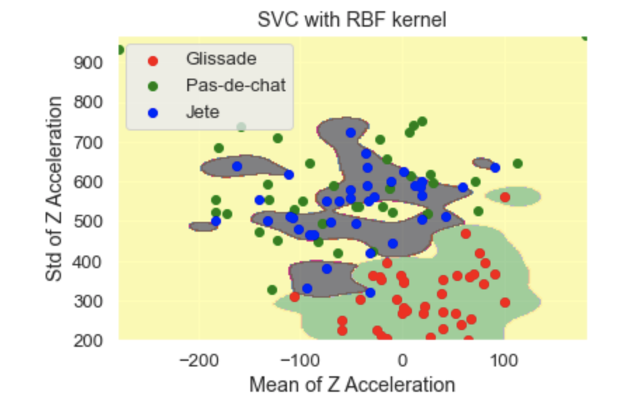
Visualizing the MODELS 2

Slide 18
Results - Jete dataset 2
 | LINEAR | POLY degree 2 | RBF
Glissade (intermediate) | 10/10 jumps -- 100% | 10/10 jumps -- 100% | 9/10 jumps -- 90%
Glissade (beginner) | 8/10 jumps -- 80% | 8/10 jumps -- 80% | 8/10 jumps -- 80%
Pas-de-chat (intermediate) | 6/10 jumps -- 60% | 7/10 jumps -- 70% | 9/10 jumps -- 90%
Pas-de-chat (beginner) | 2/10 jumps -- 20% | 4/10 jumps -- 40% | 7/10 jumps -- 70%
Jete (intermediate) | 5/10 jumps -- 50% | 7/10 jumps -- 70% | 5/10 jumps -- 50%
Jete (beginner) | 9/11 jumps -- 82% | 8/11 jumps -- 73% | 4/11 jumps -- 36%
Accuracy table for SVM models using Acceleration features (Mean_Z and Std_Z)
Total Accuracy Intermediate dancer | 70% | 80% | 77%

Slide 19
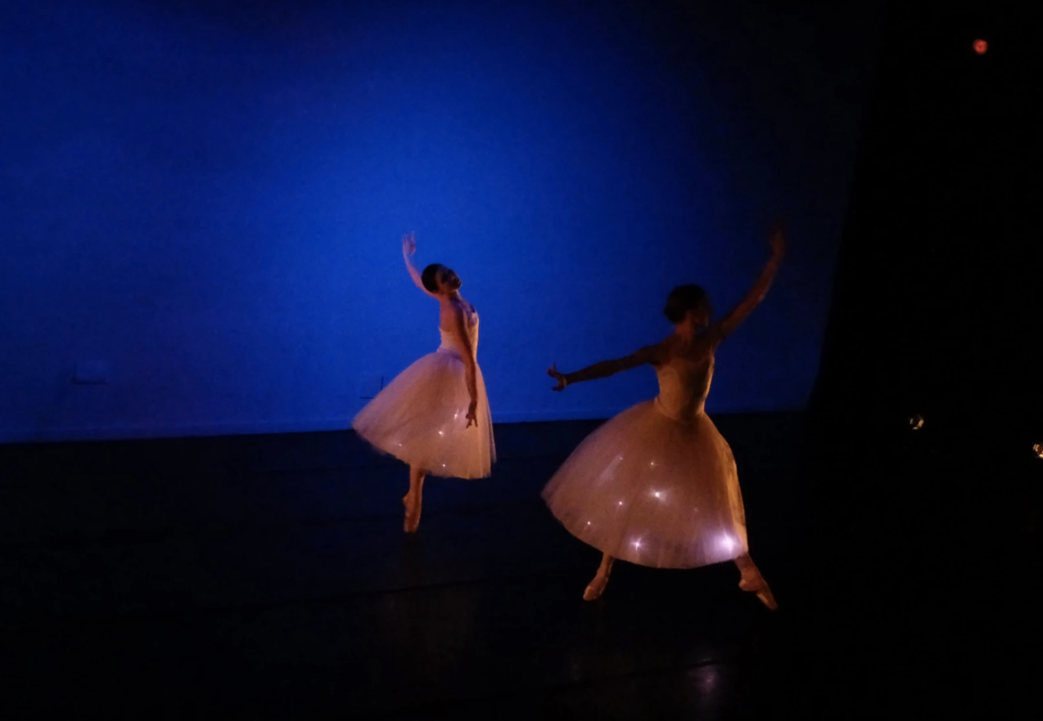
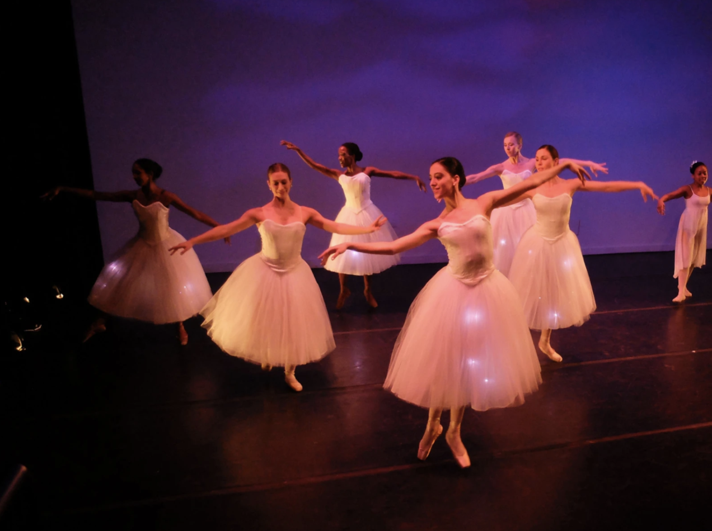
Possible Applications
To practice specific ballet moves
Ballet competitions (stats of specific moves or jumps)
Figure skating competitions (stats of specific jumps)
Choreograph lights to ballet steps
Document a choreography
https://www.vice.com/en_uk/article/9anb8y/brooklyn-ballet-kicks-off-tonight-with-wearable-enhanced-techno-tutus

Slide 20
Improvements
Increase FS of the accelerometer to 4G because our data saturates at 2G
Add additional features to try to better train the model
Collect more data to train the model and use multiple dancers to train the model
Collecting data with the sensor on the foot instead of the ankle
Collecting data with at least 2 sensors (one on each foot)

